Slide 1
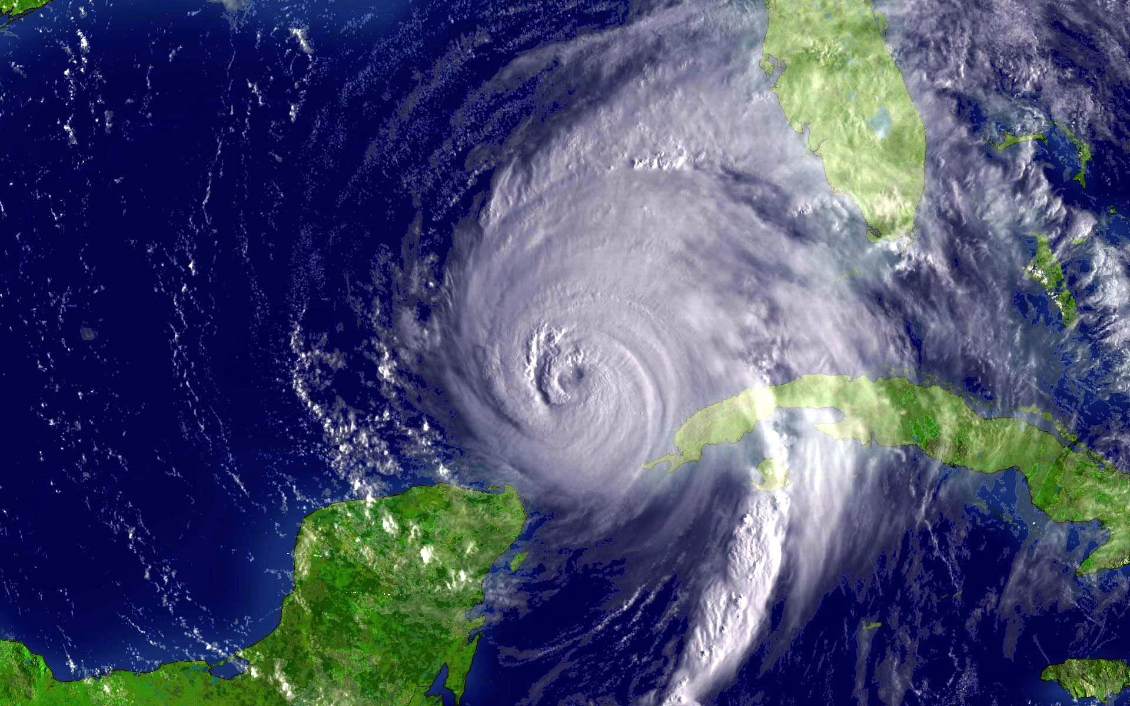
Advancing HWRF and GFDL/GFDN Prediction Systems Through New and Enhanced Physics of the Air-Sea-Wave Coupling Planned for 2013
Isaac Ginis, Richard Yablonsky, Biju Thomas (URI)
Vijay Tallapragada, Hendrik Tolman (NCEP/NOAA), Morris Bender (GFDL/NOAA)
Funding for this project is provided by NOAA’s HFIP and JHT
Interdepartmental Hurricane Conference, March 2012
67th IHC, 6 March 2013

Slide 2
Major Upgrades of the Operational HWRF and GFDL Ocean Components: Transitioning from Princeton Ocean Model (POM-TC) to MPIPOM-TC

Slide 3
Why create a new MPIPOM-TC?
MPIPOM-TC uses MPI software framework for running on multiple processors, allowing for both higher resolution and larger domain sizes
MPIPOM-TC accepts flexible initialization options
MPIPOM-TC is an adaptation of sbPOM, which has community support and includes 18 years of physics updates and bug fixes
MPIPOM-TC is a modernized code with netCDF I/O

Slide 4
Developing a new MPIPOM-TC at URI
POM community code development
2004
pom2k
2012
sbPOM
1977
pmod
1994
pom
2004 POM
Users Guide
2012 HWRF
Users Guide
URI’s new
MPIPOM-TC
1994 pom
at URI
2012
POM-TC
URI-based code development

Slide 5
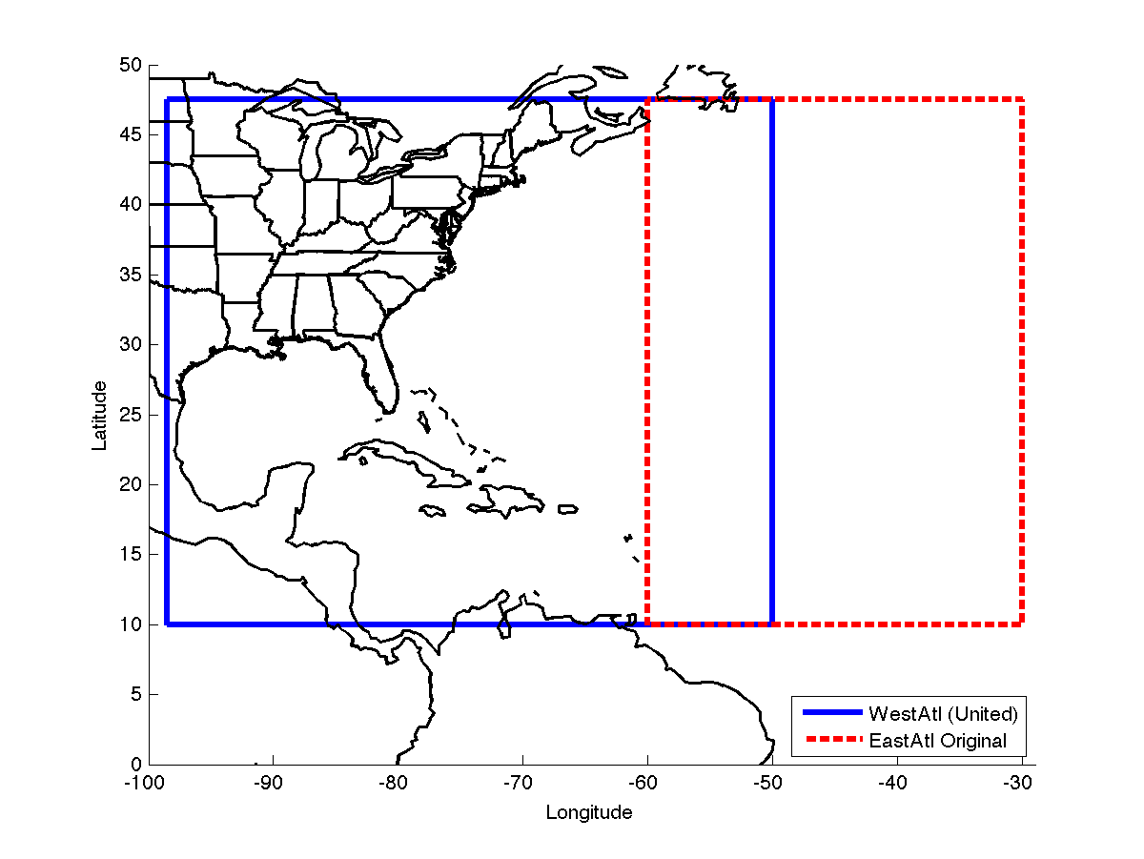
POM-TC Operational United and East Atlantic domains
~1/6°
horizontal
grid spacing

Slide 6
New MPIPOM-TC Transatlantic Domain
~1/12°
horizontal
grid spacing

Slide 7
MPIPOM-TC Initialization Options
Global HYCOM - utilizes Navy Coupled Ocean Data Assimilation (NCODA), which incorporates satellite, buoy, AXBT, and float data, when available
Global RTOFS - initialized from Global HYCOM and forced by GFS thermal and wind forcing
Feature-based - initialized from GDEM monthly T and S climatology, uses SSH real-time analysis to determine feature boundaries, sharpens fronts and assimilates daily NCEP GFS SST

Slide 8
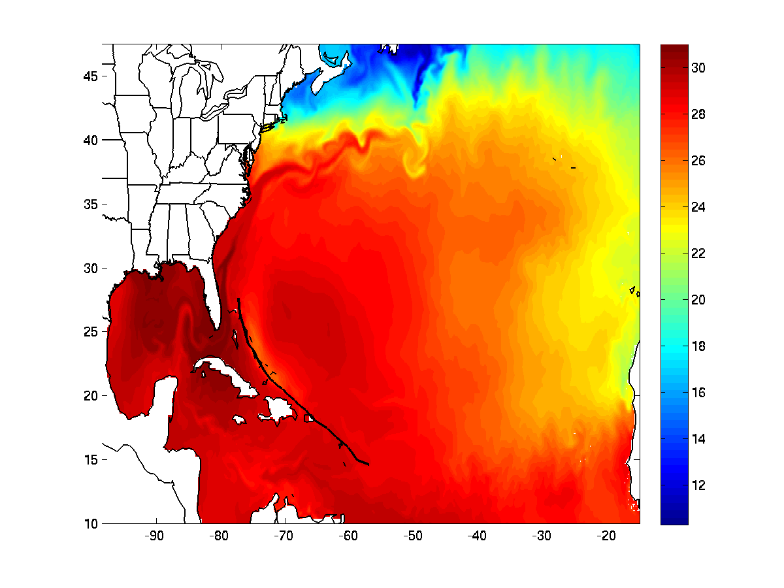
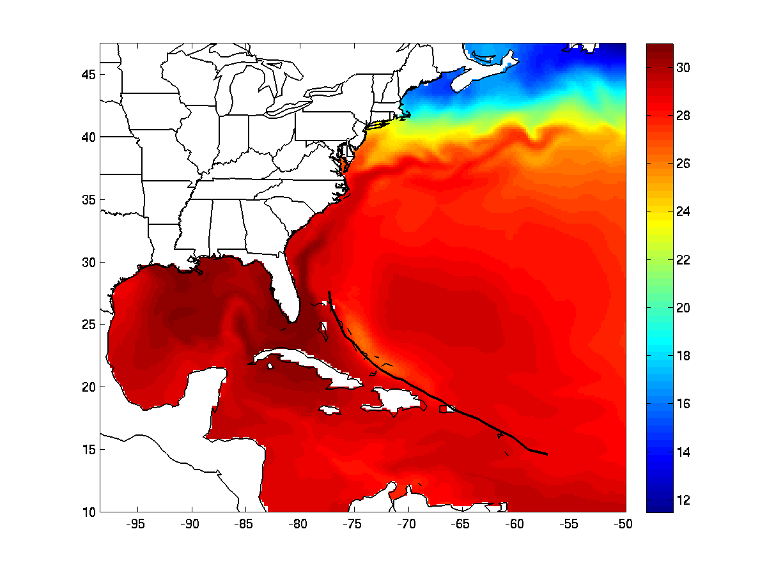
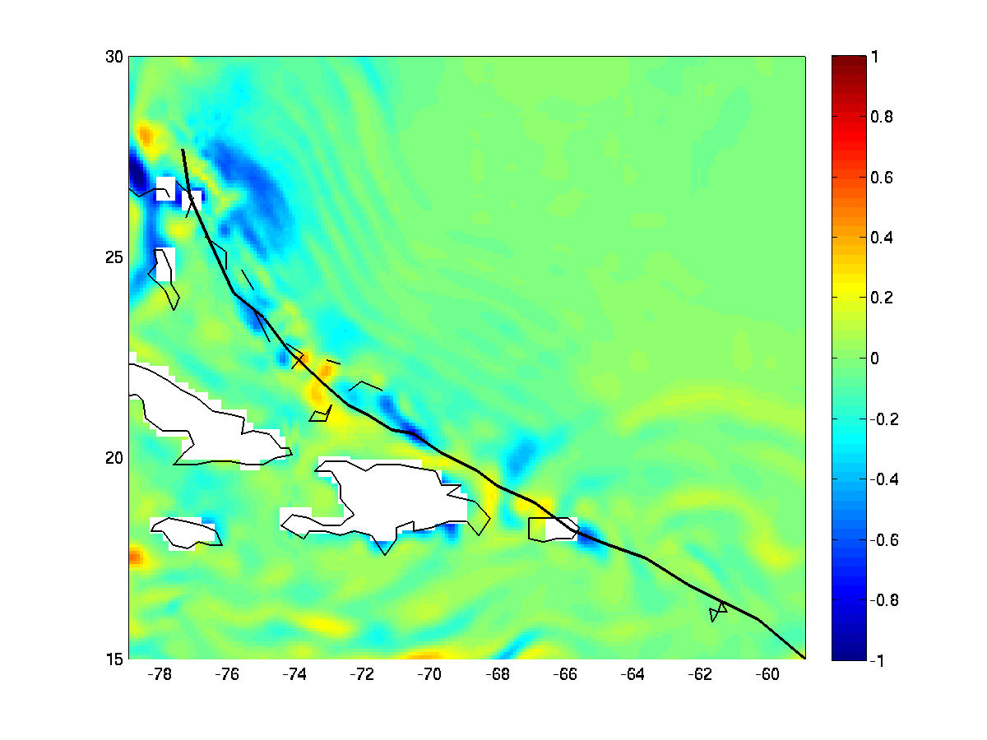
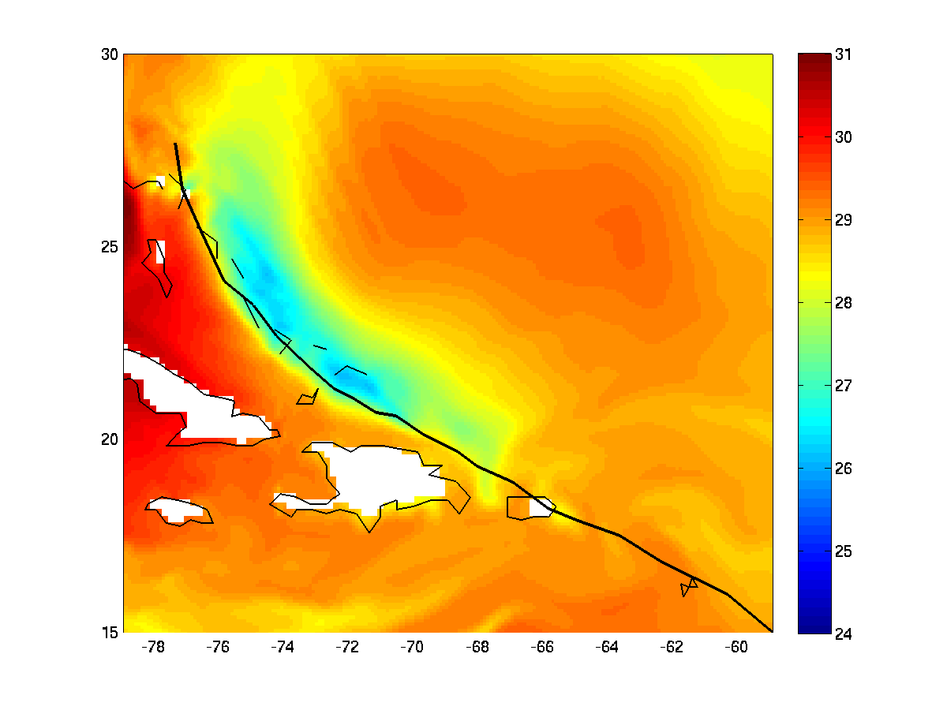
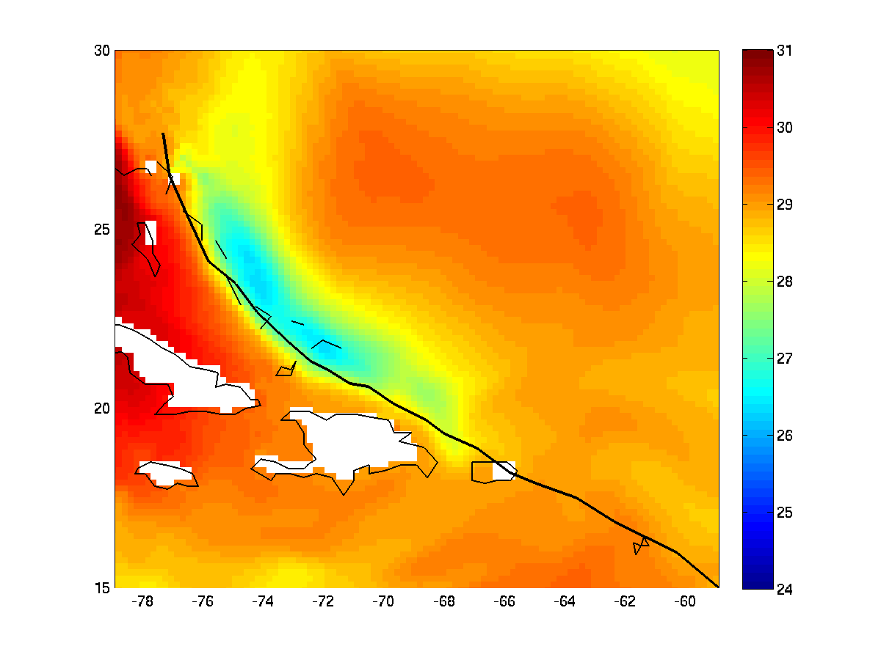
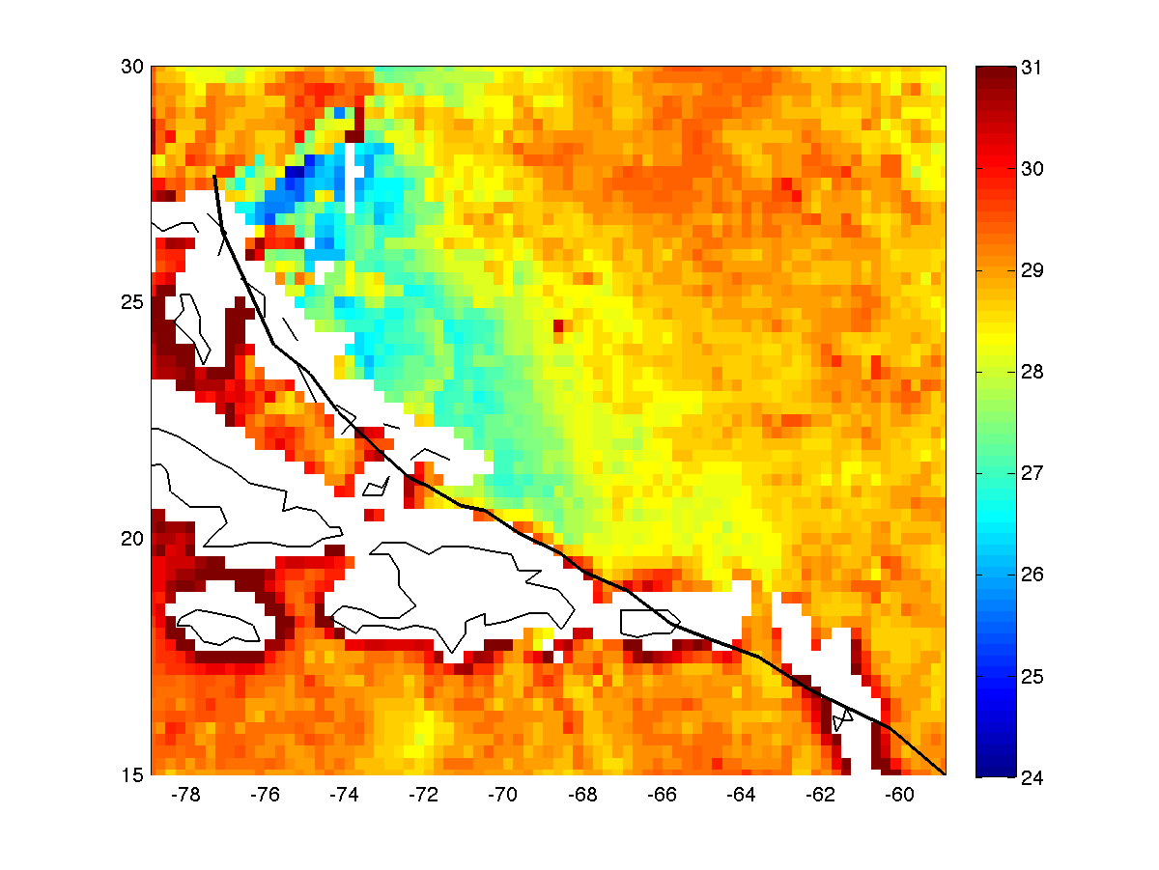
MPIPOM-TC vs. POM-TC (FB initialization): Hurricane Irene Observed wind forcing through 00Z 26 Aug 2011
MPIPOM-TC SST (full domain)
POM-TC SST (full domain)
MPIPOM-TC – POM-TC SST
MPIPOM-TC SST (wake only)
POM-TC SST (wake only)
8/26 TMI 3-day SST

Slide 9
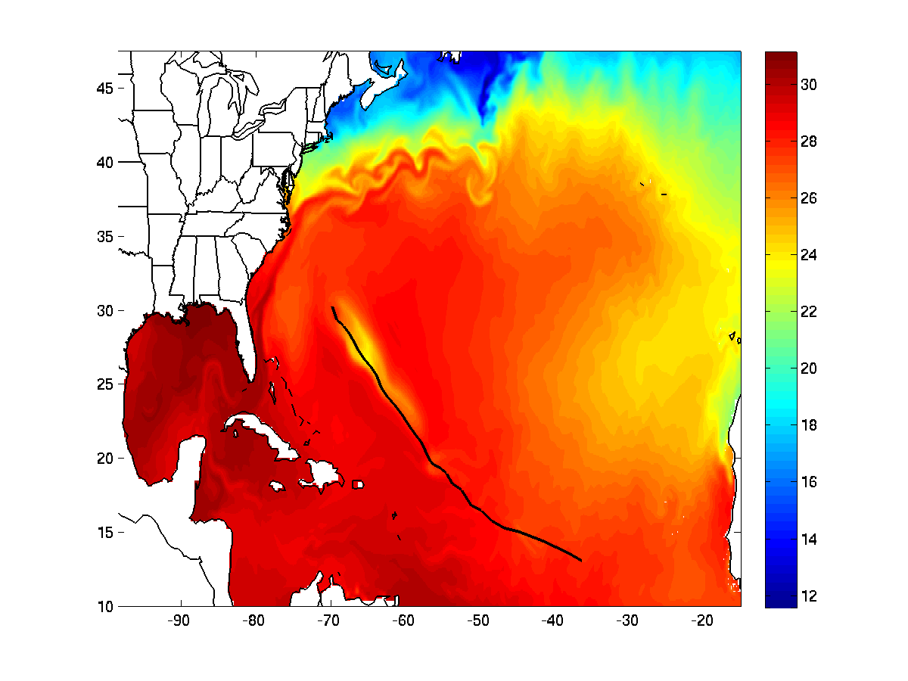
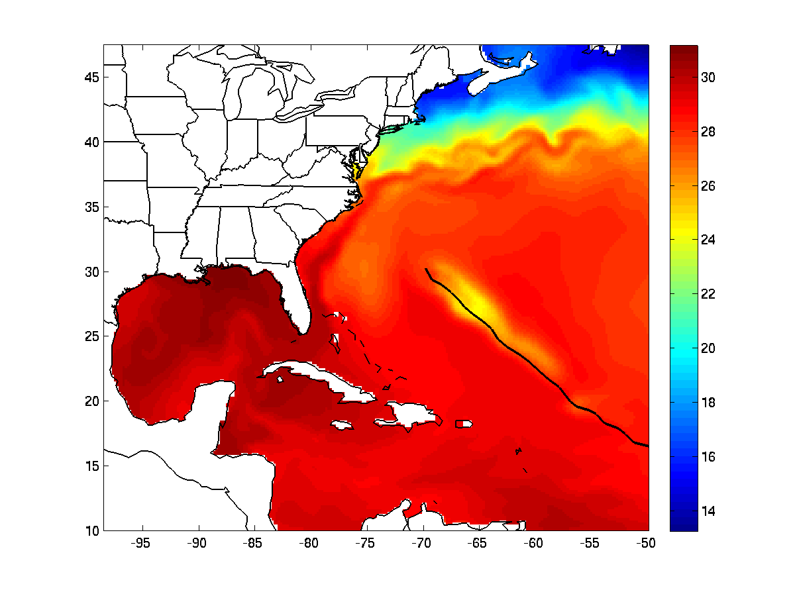
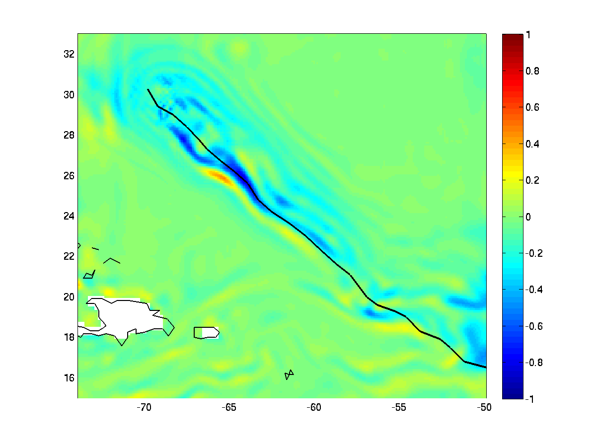
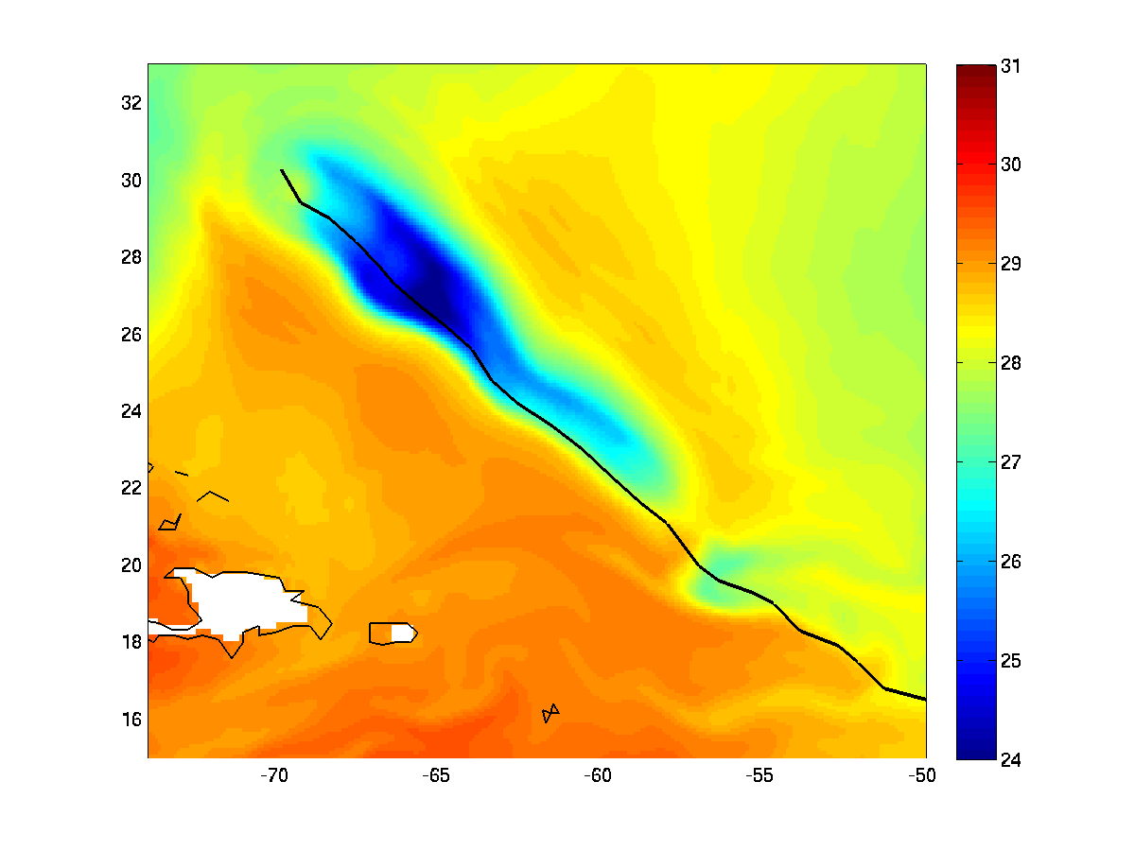
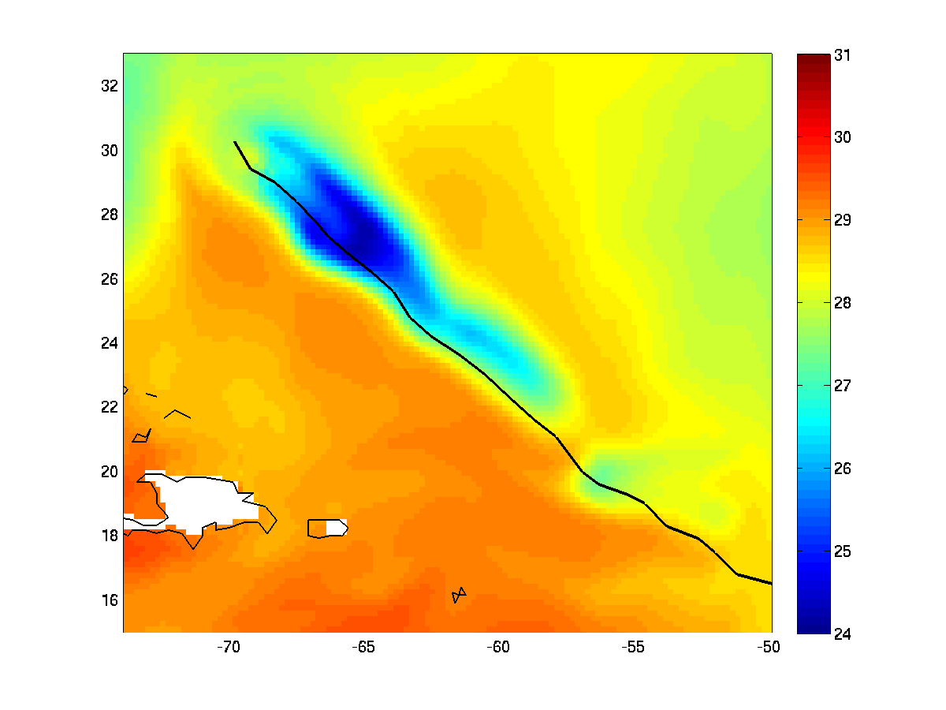
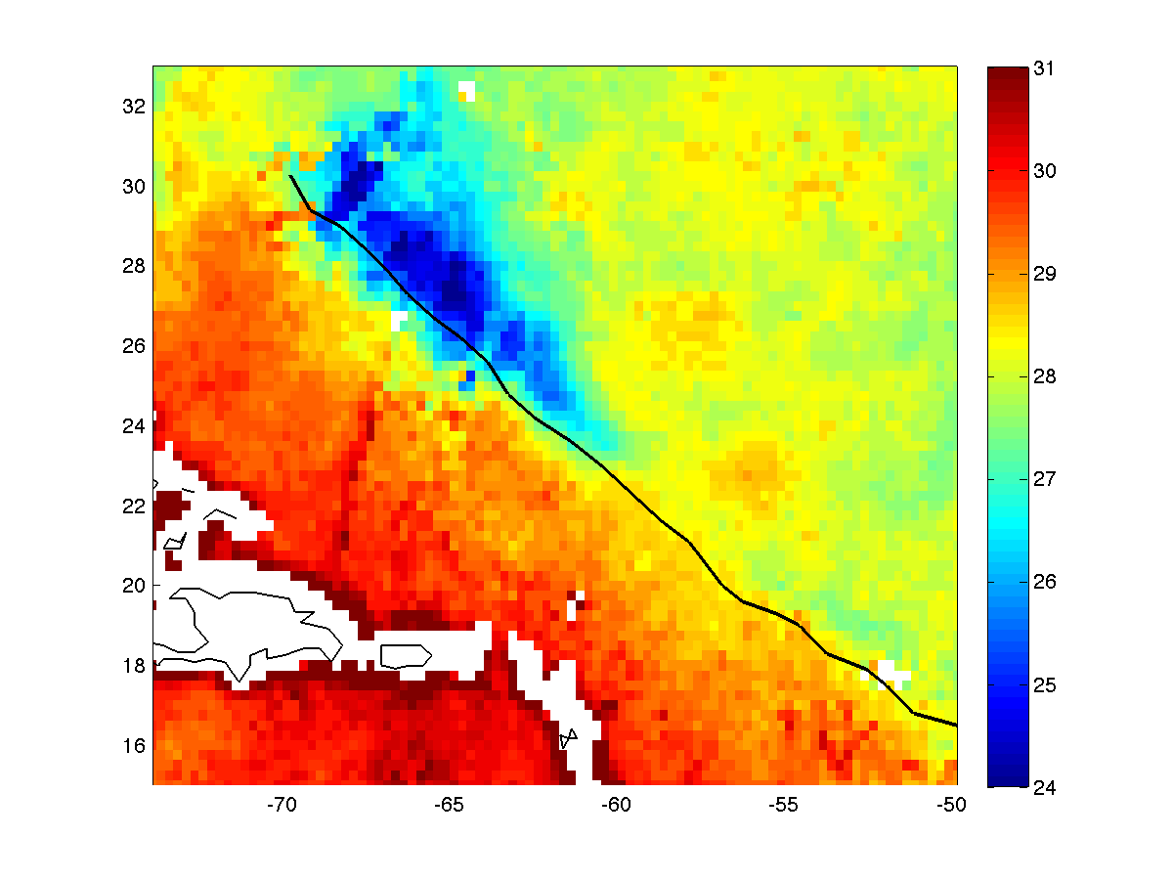
MPIPOM-TC vs. POM-TC (FB initialization): Hurricane Katia Observed wind forcing through 00Z 08 Sep 2011
MPIPOM-TC SST (full domain)
POM-TC SST (full domain)
MPIPOM-TC – POM-TC SST
MPIPOM-TC SST (wake only)
POM-TC SST (wake only)
9/08 TMI 3-day SST

Slide 10
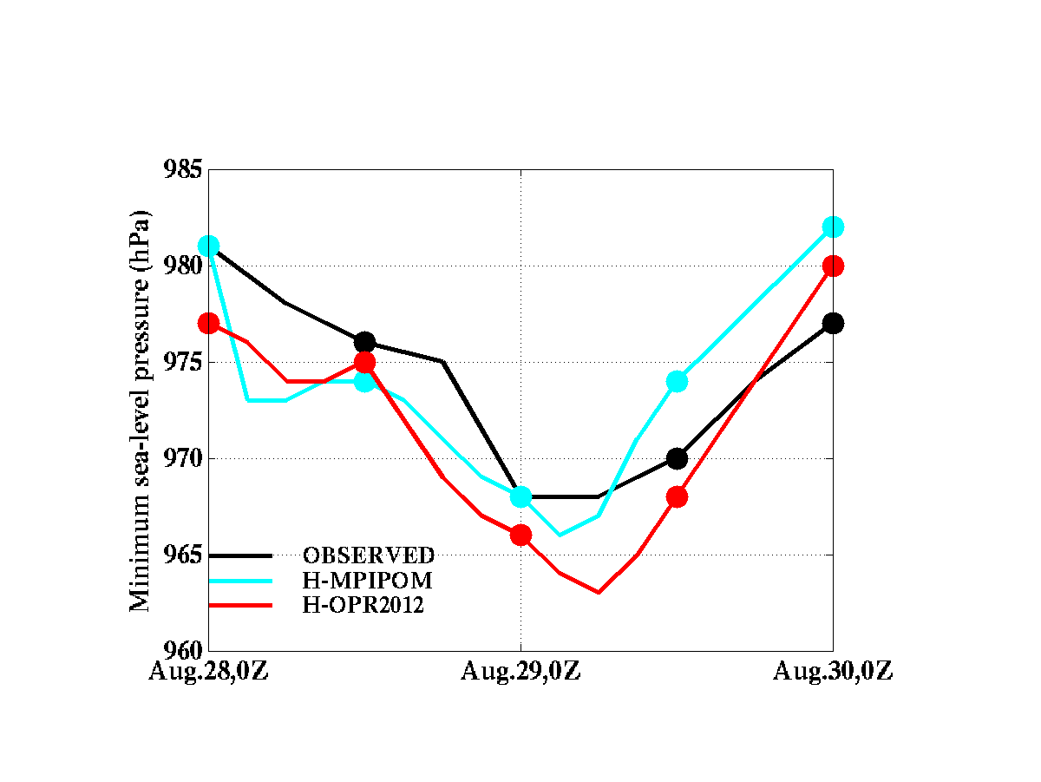
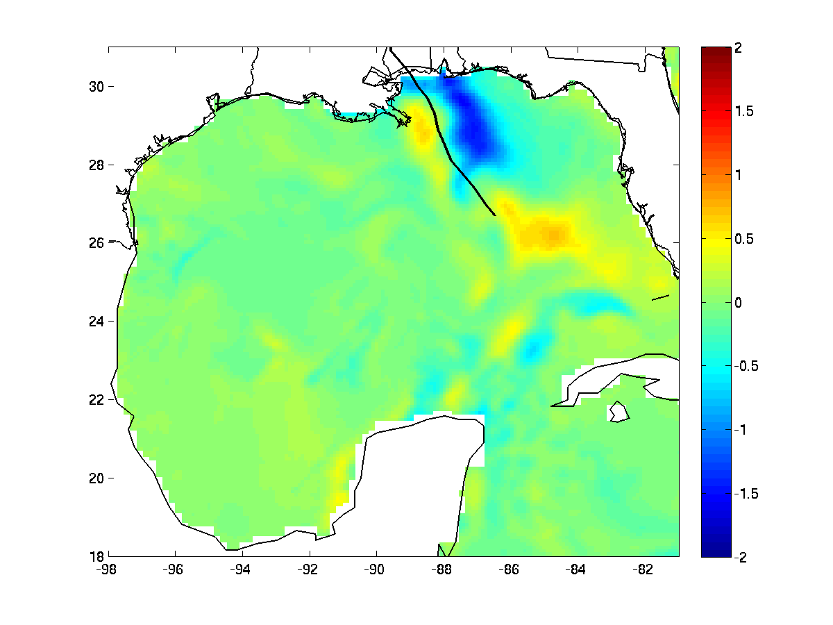
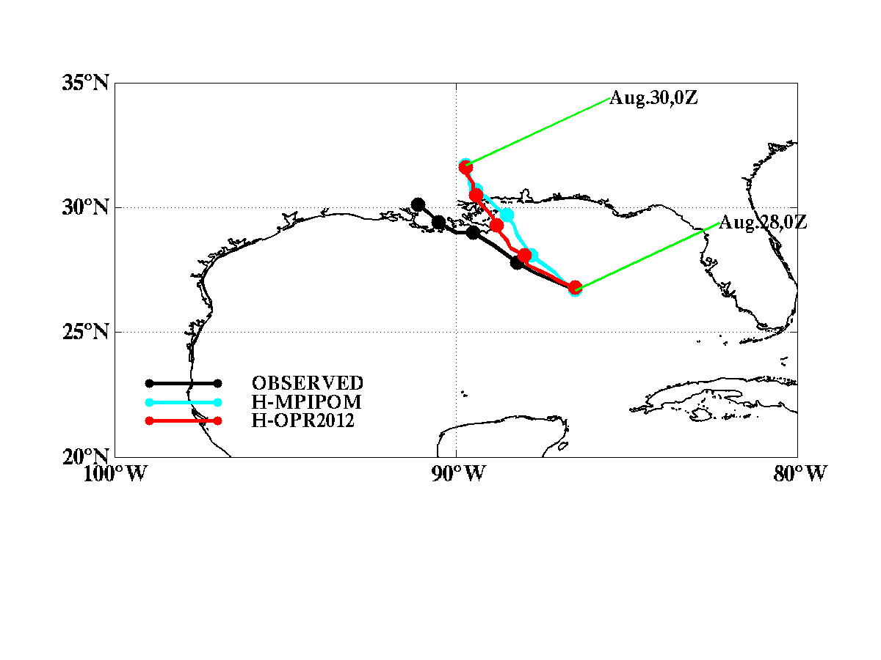
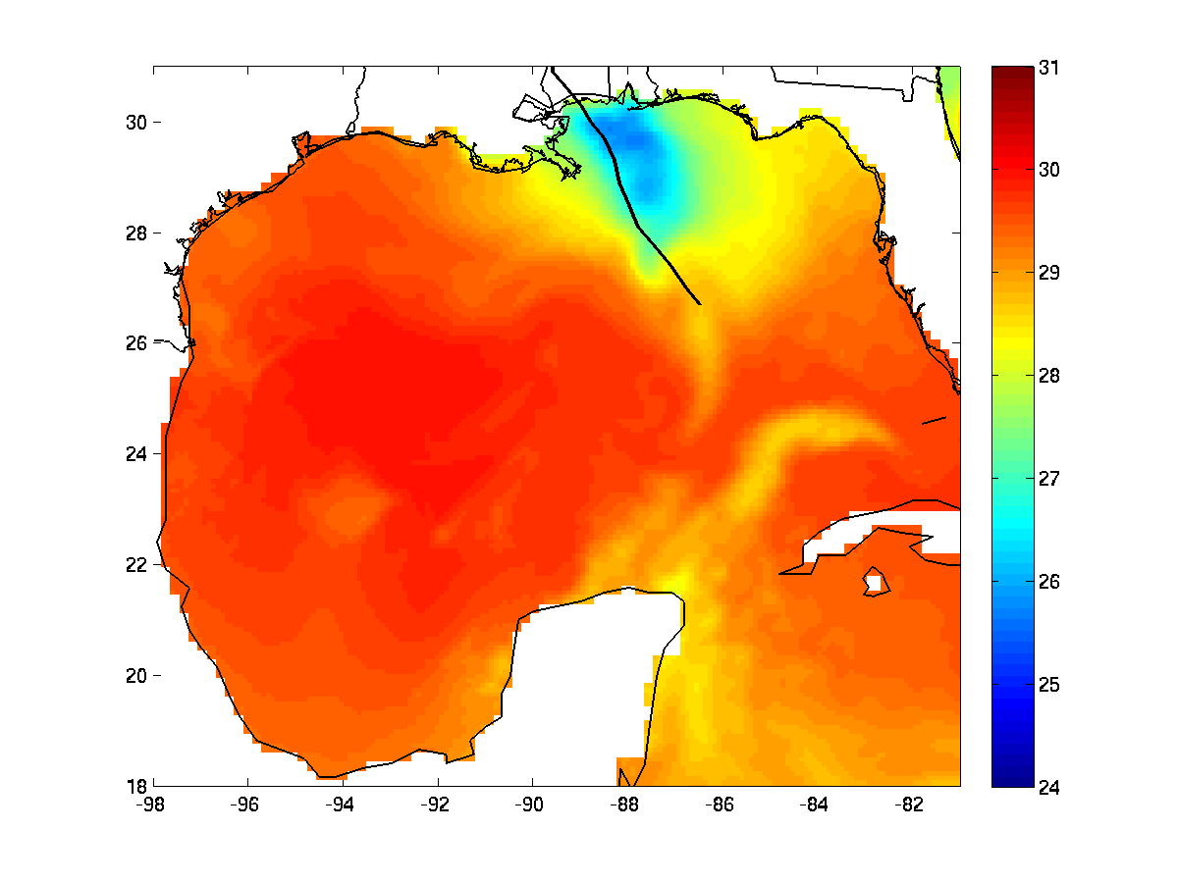
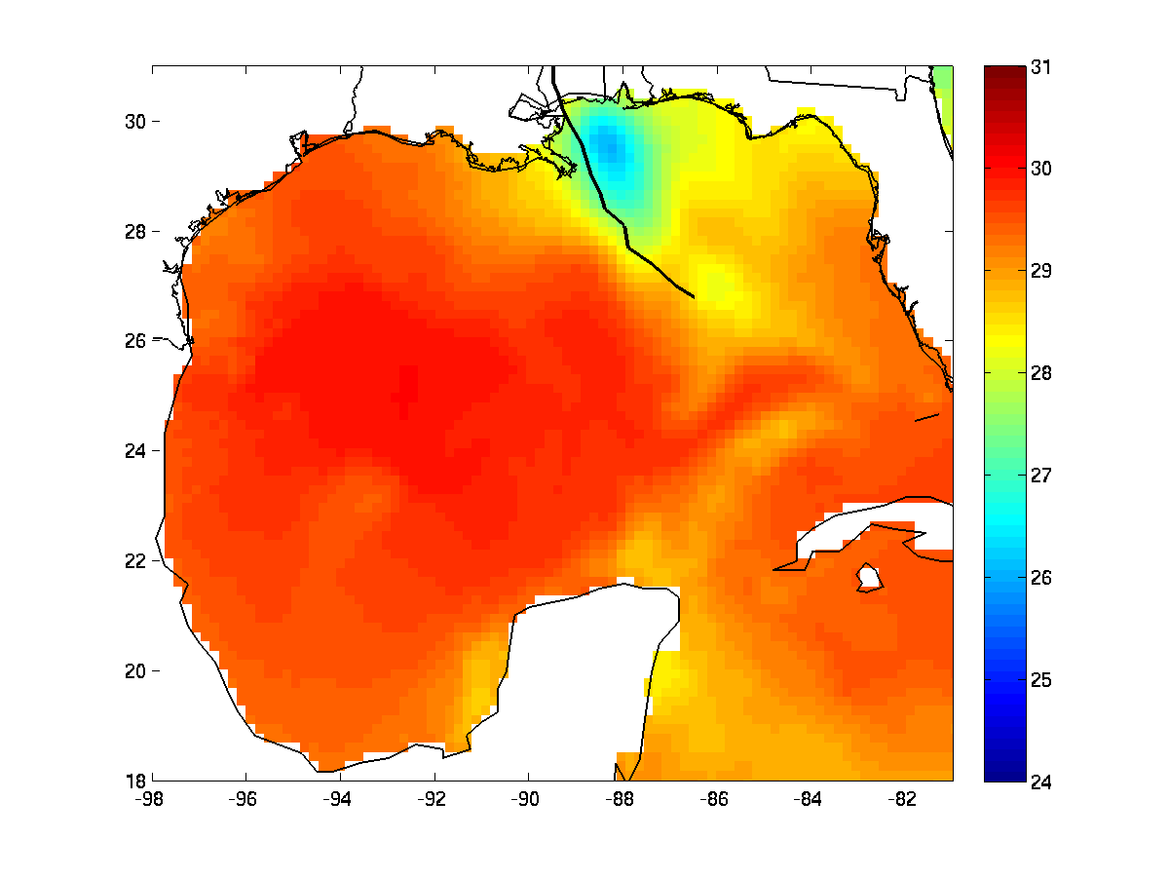
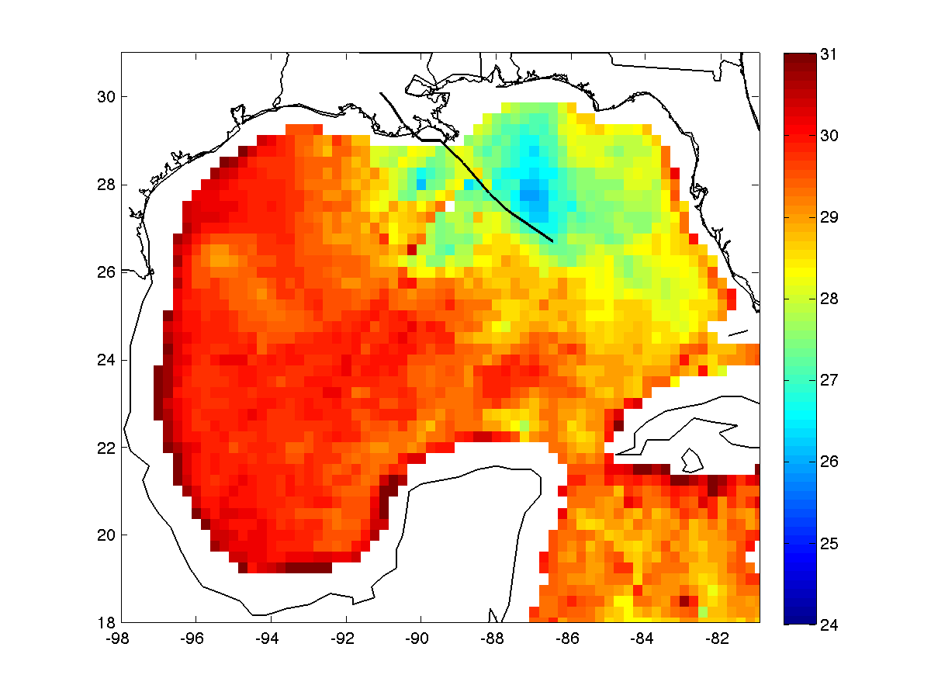
MPIPOM-TC vs. POM-TC (FB initialization): Hurricane Isaac 48-h HWRF coupled forecast 00Z 30 Aug 2012
HWRF Track Forecasts
HWRF Intensity Forecasts
MPIPOM-TC – POM-TC SST
MPIPOM-TC SST
POM-TC SST
8/30 TMI 3-day SST

Slide 11
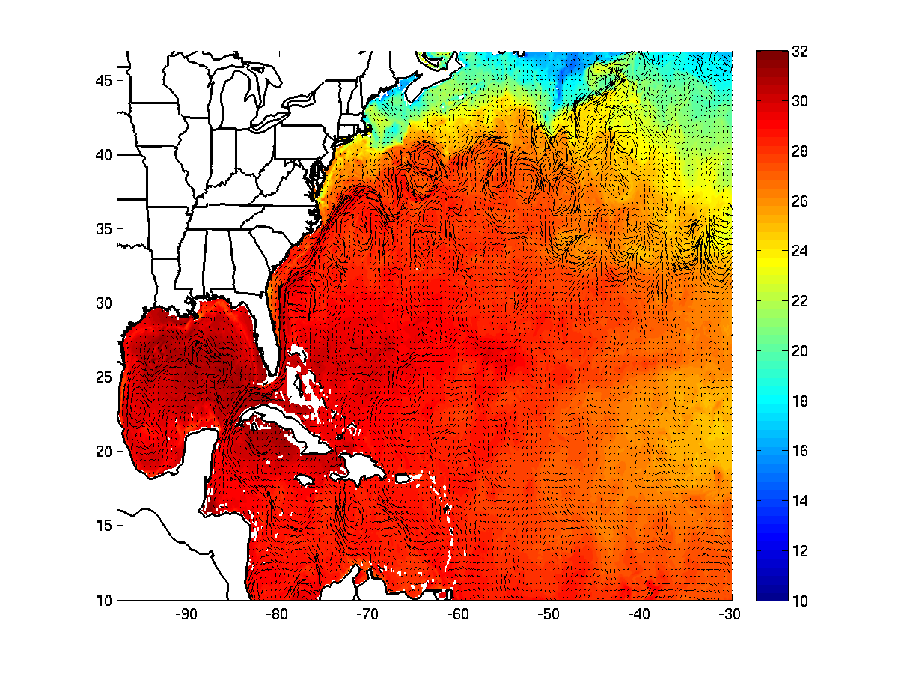
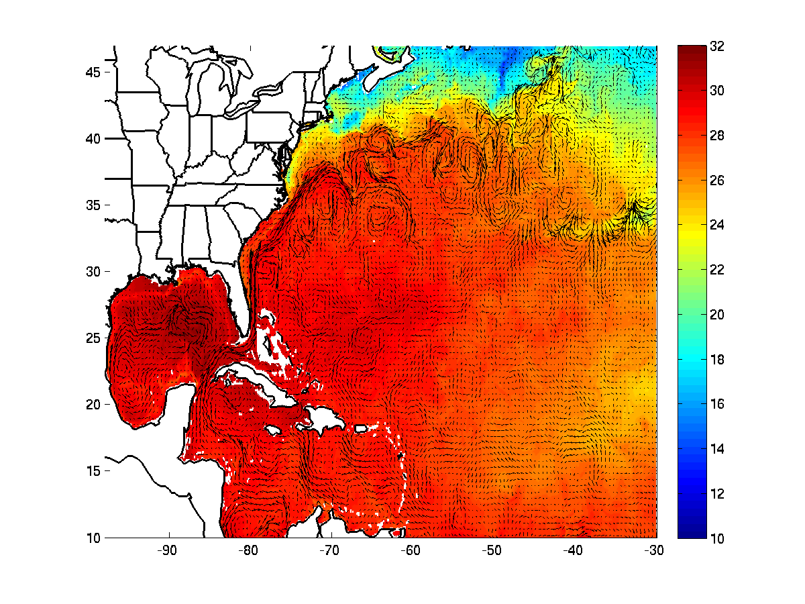
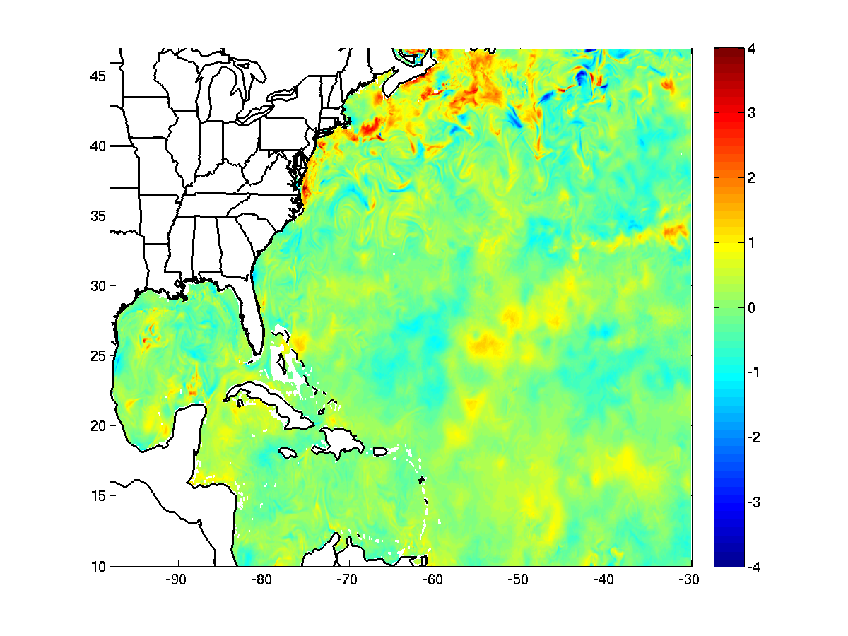
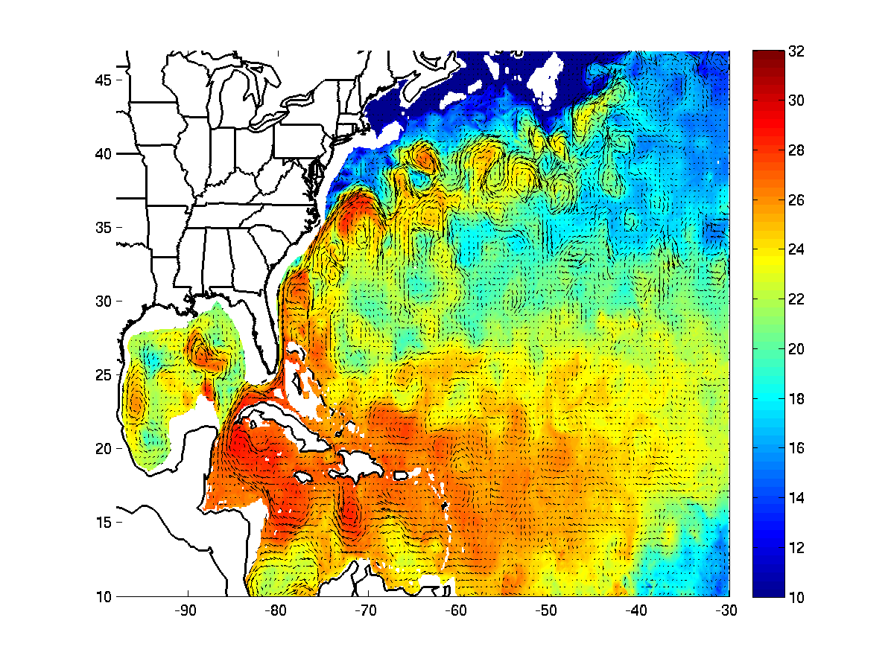
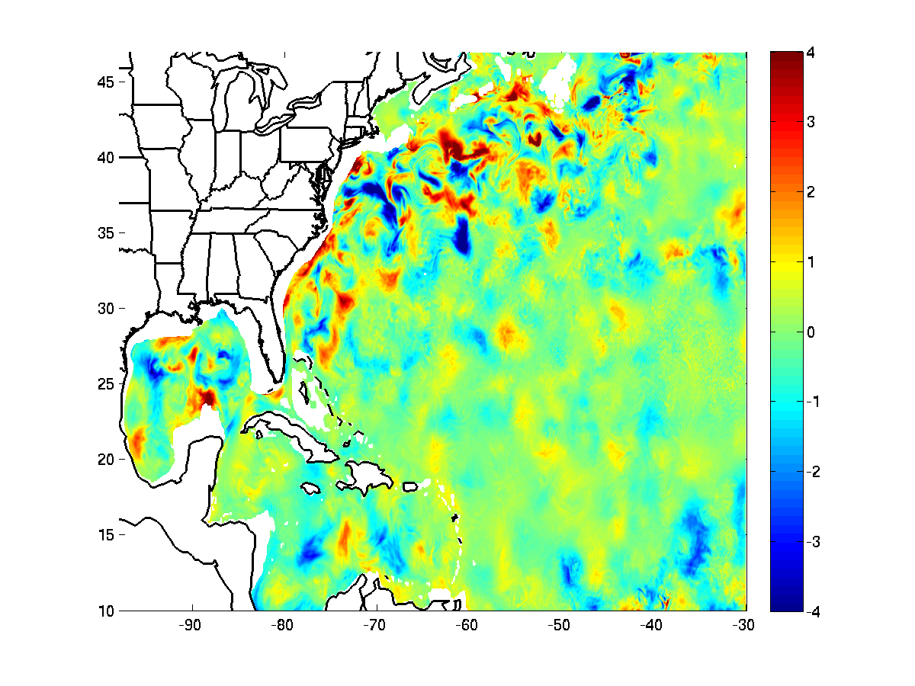
MPIPOM-TC: Global HYCOM or Global RTOFS initialization (20120828)
HYCOM SST init
RTOFS SST init
HYCOM-RTOFS SST init
HYCOM 75-m T init
RTOFS 75-m T init
HYCOM-RTOFS 75-m T init

Slide 12
Evaluating ocean model initializations for hurricane prediction
Initializations Tested:
HYCOM: Global HYCOM
FB: Feature-based
FB-CCAR: Feature-based with only Colorado Center for Astrodyanmic Research (CCAR) SSH data assimilated
FB-AXBT: Feature-based with CCAR SSH and AXBT data assimilated to adjust ring position and profiles
FB-AXBT-POSONLY: Feature-based with CCAR SSH and AXBT data assimilated to adjust ring position only

Slide 13
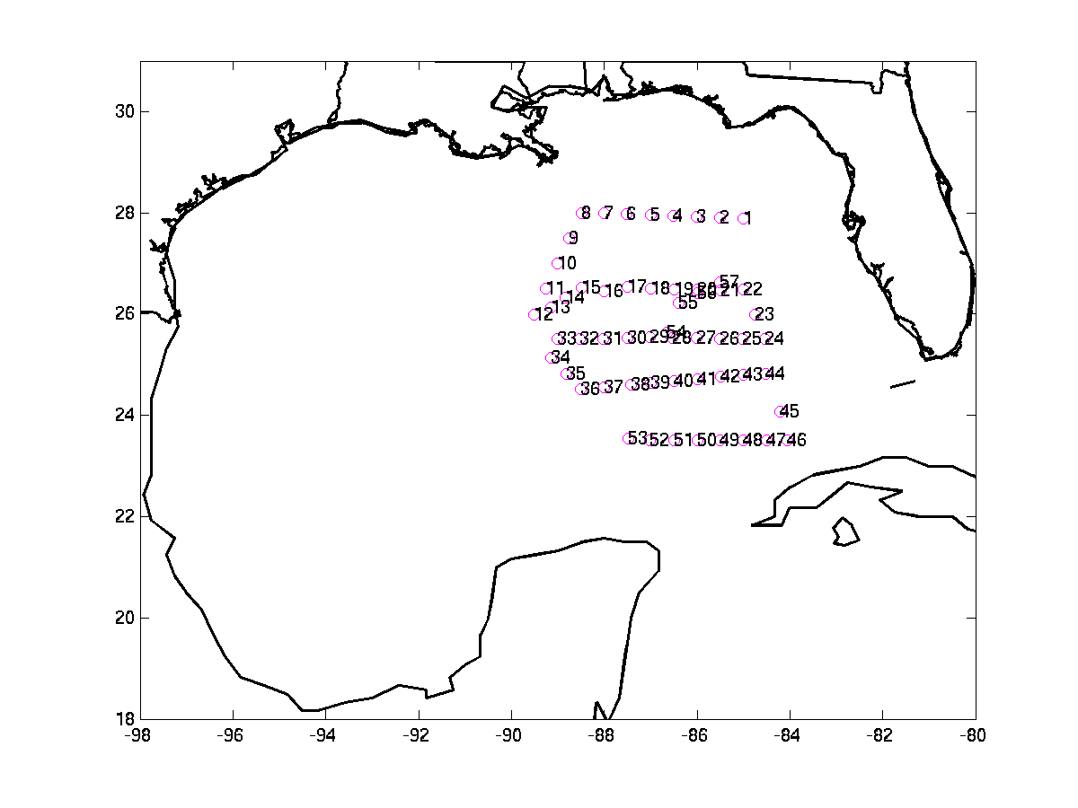
AXBT Survey-July 16, 2009
Latitude
Longitude
57 AXBTs deployed by NOAA/AOML/HRD to access SST and ocean heat content (OHC) in the Gulf of Mexico

Slide 14
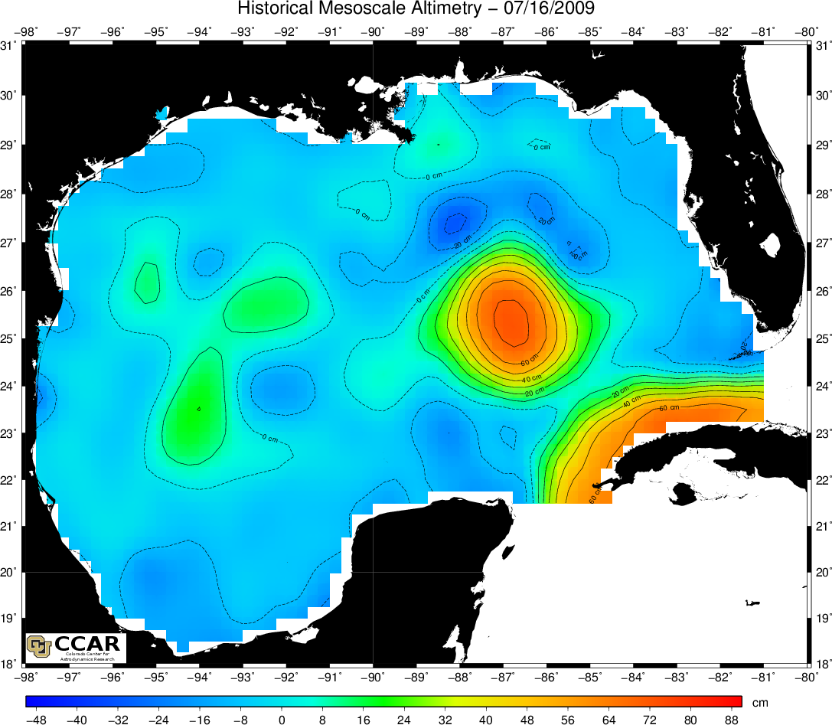
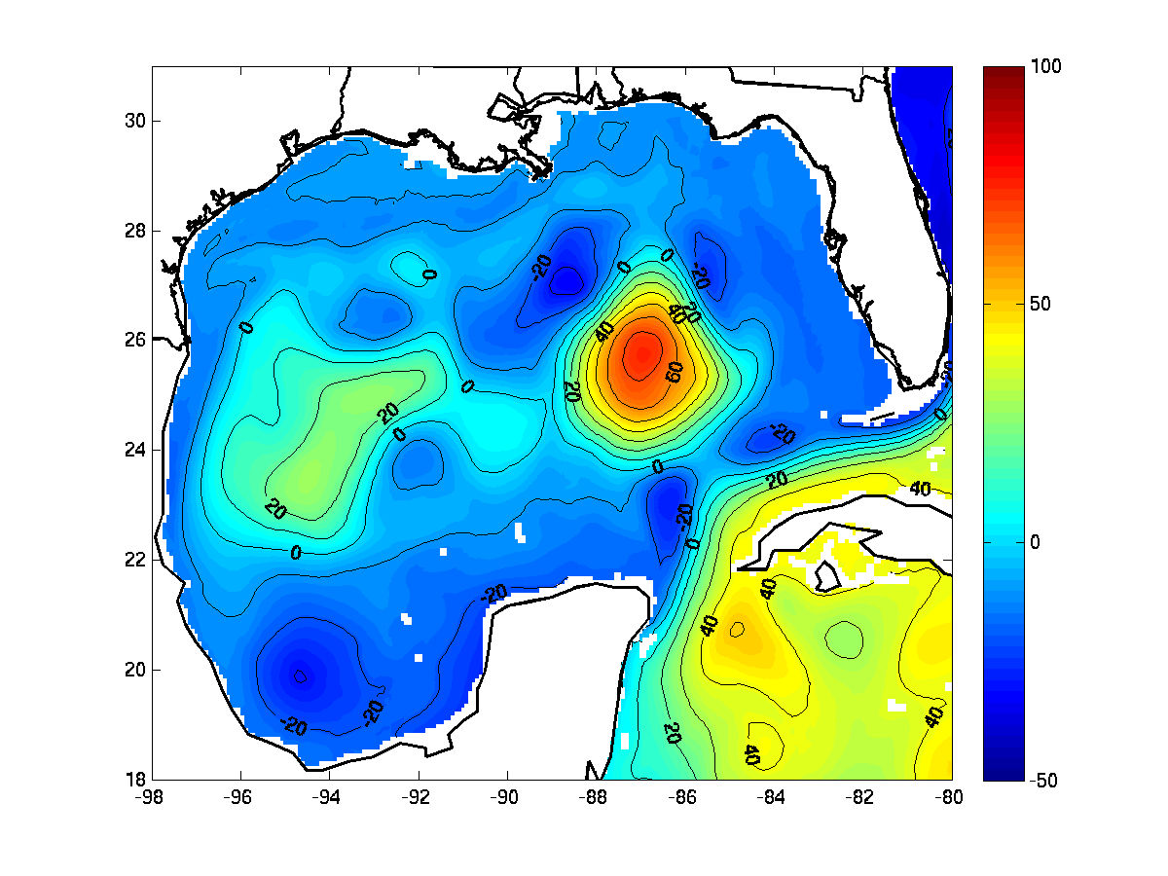
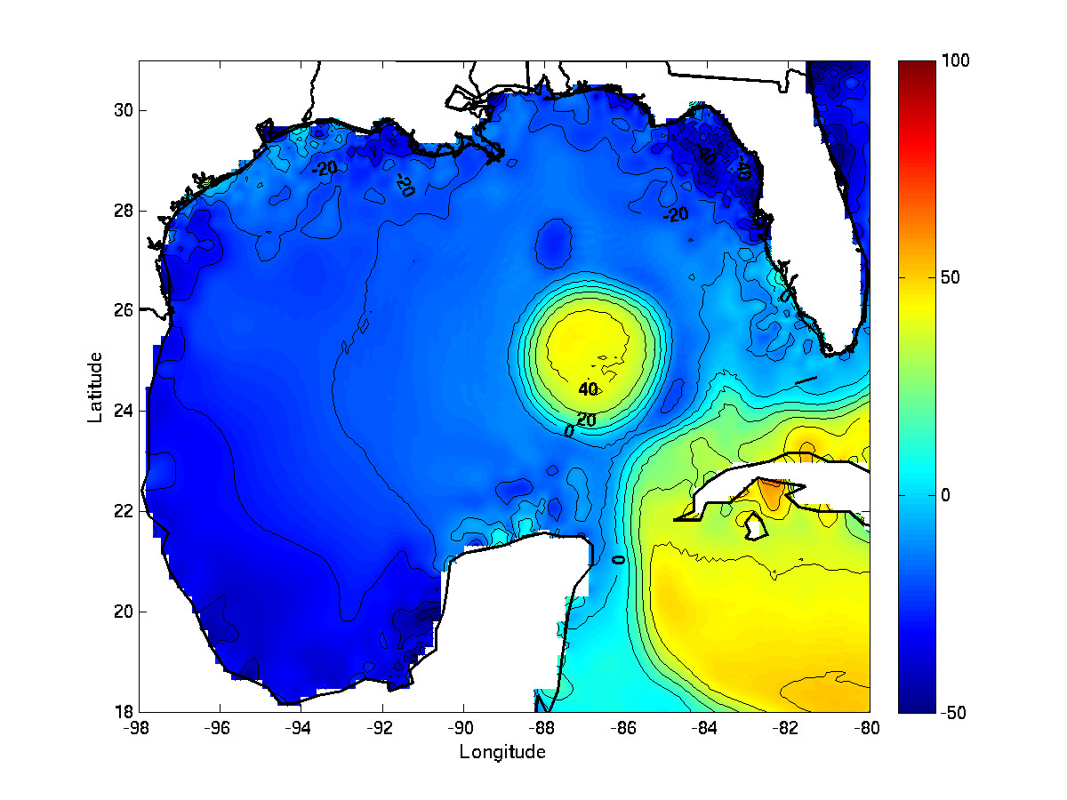
Sea Surface Height
CCAR
HYCOM
FB-CCAR
FB-AXBT

Slide 15
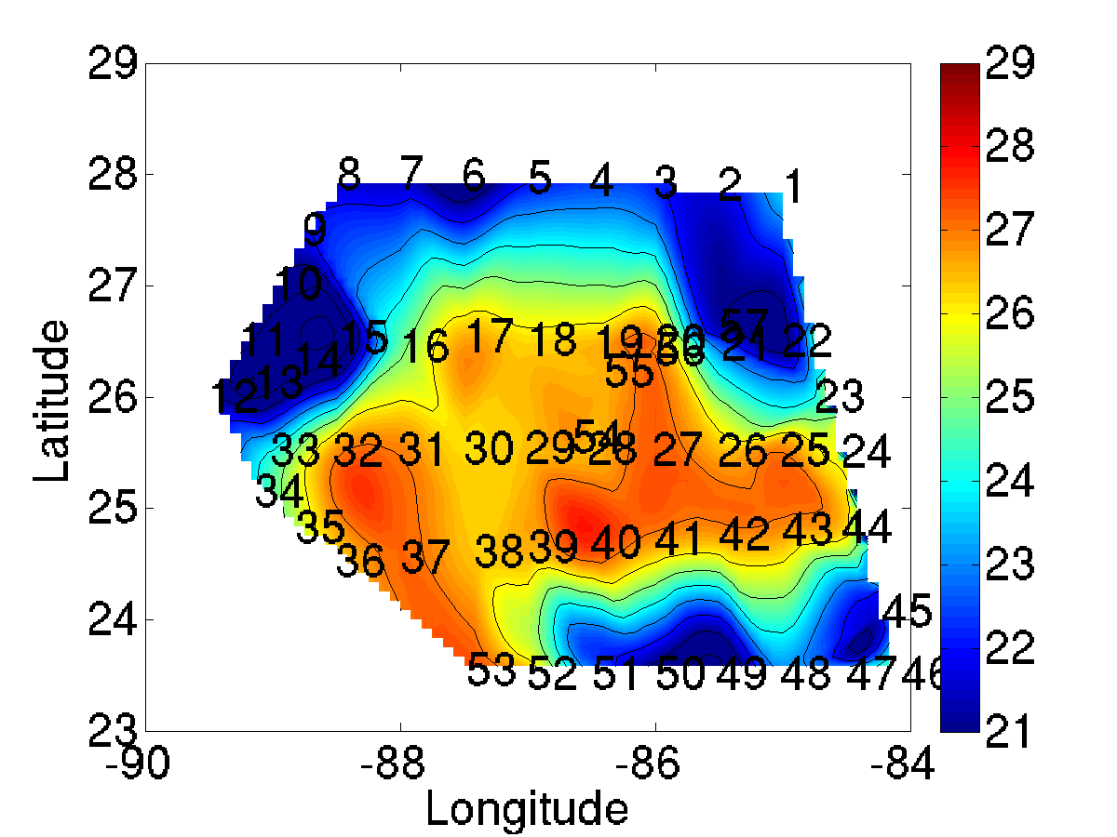
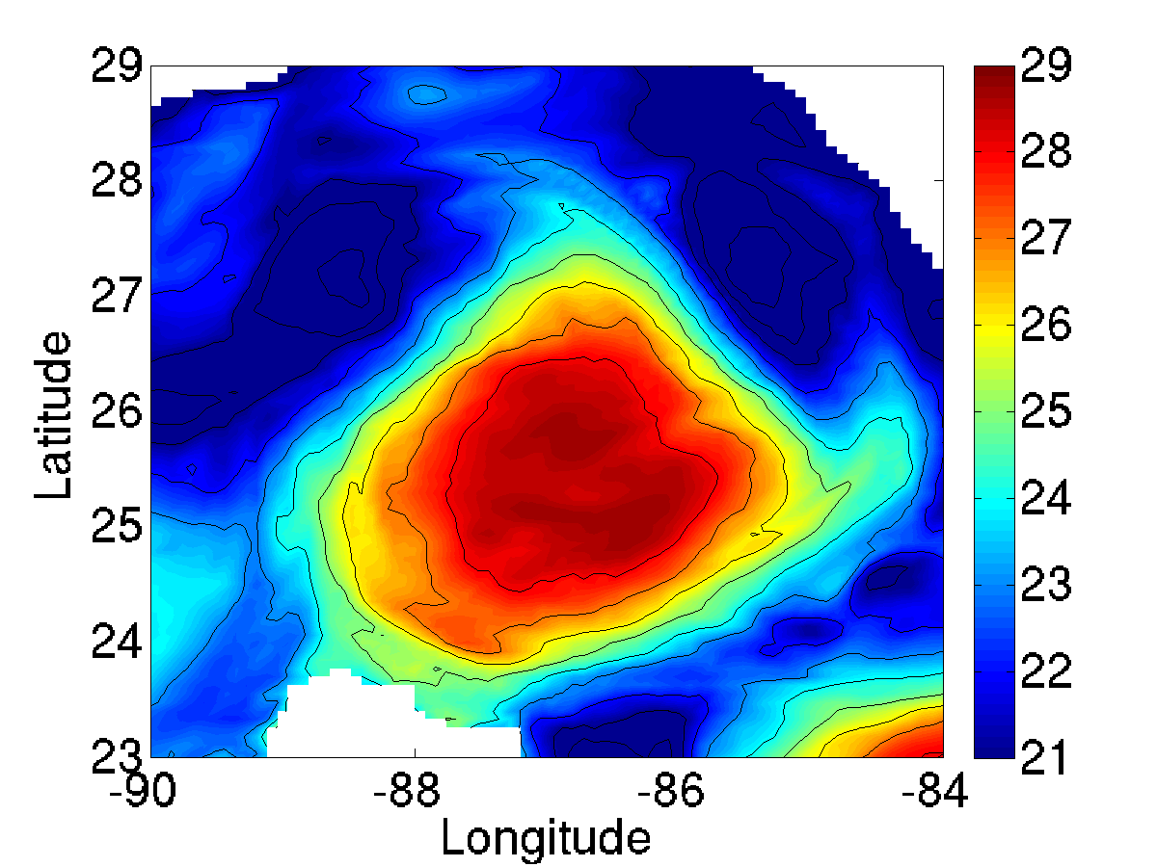
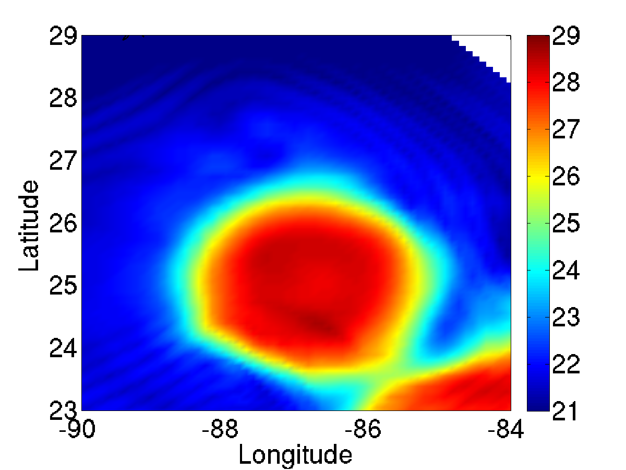
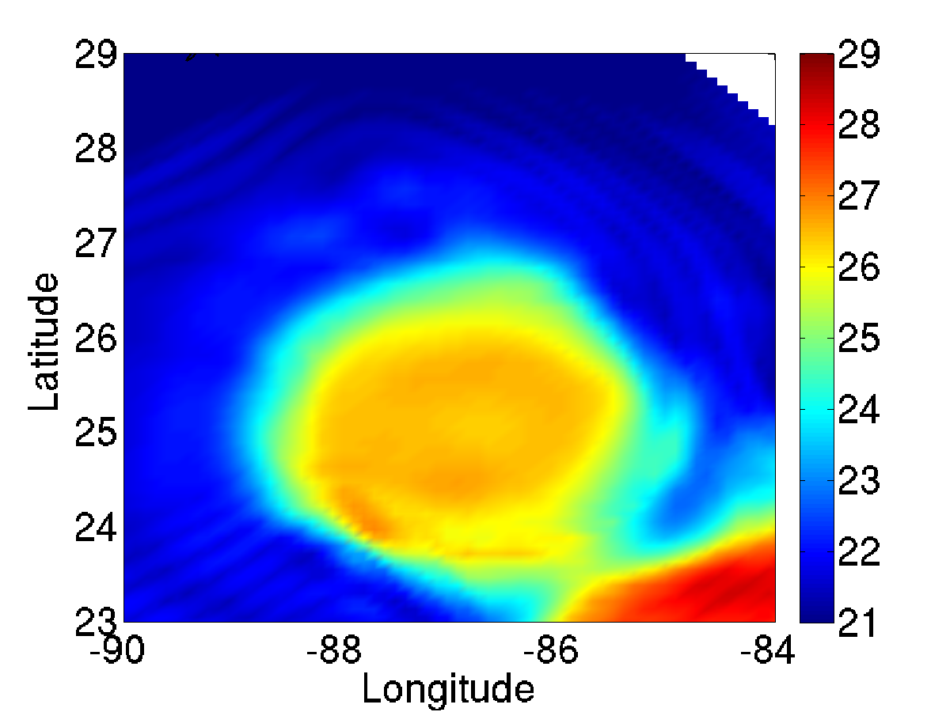
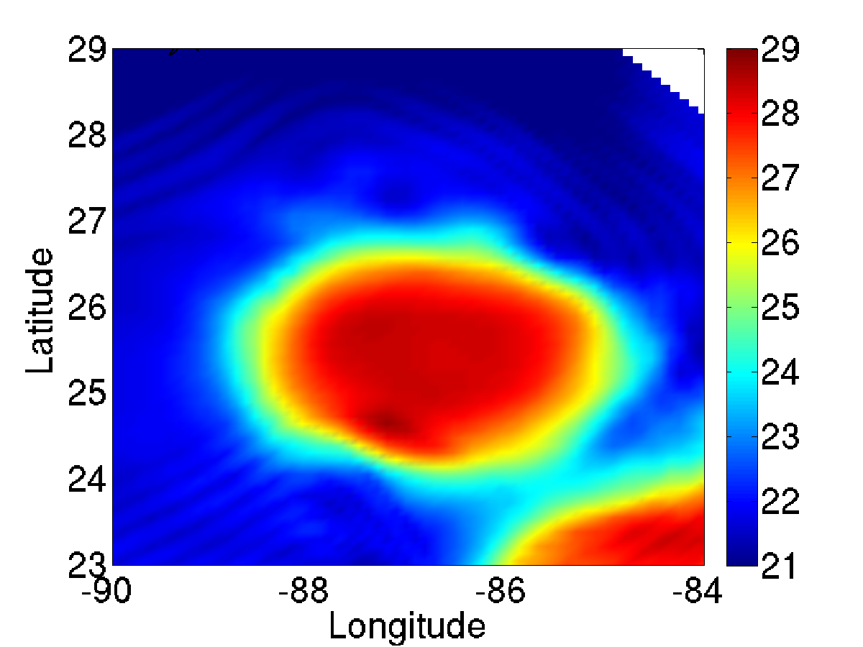
75-m Temperature
AXBT
HYCOM
FB-CCAR
FB-AXBT-POSONLY
FB-AXBT

Slide 16
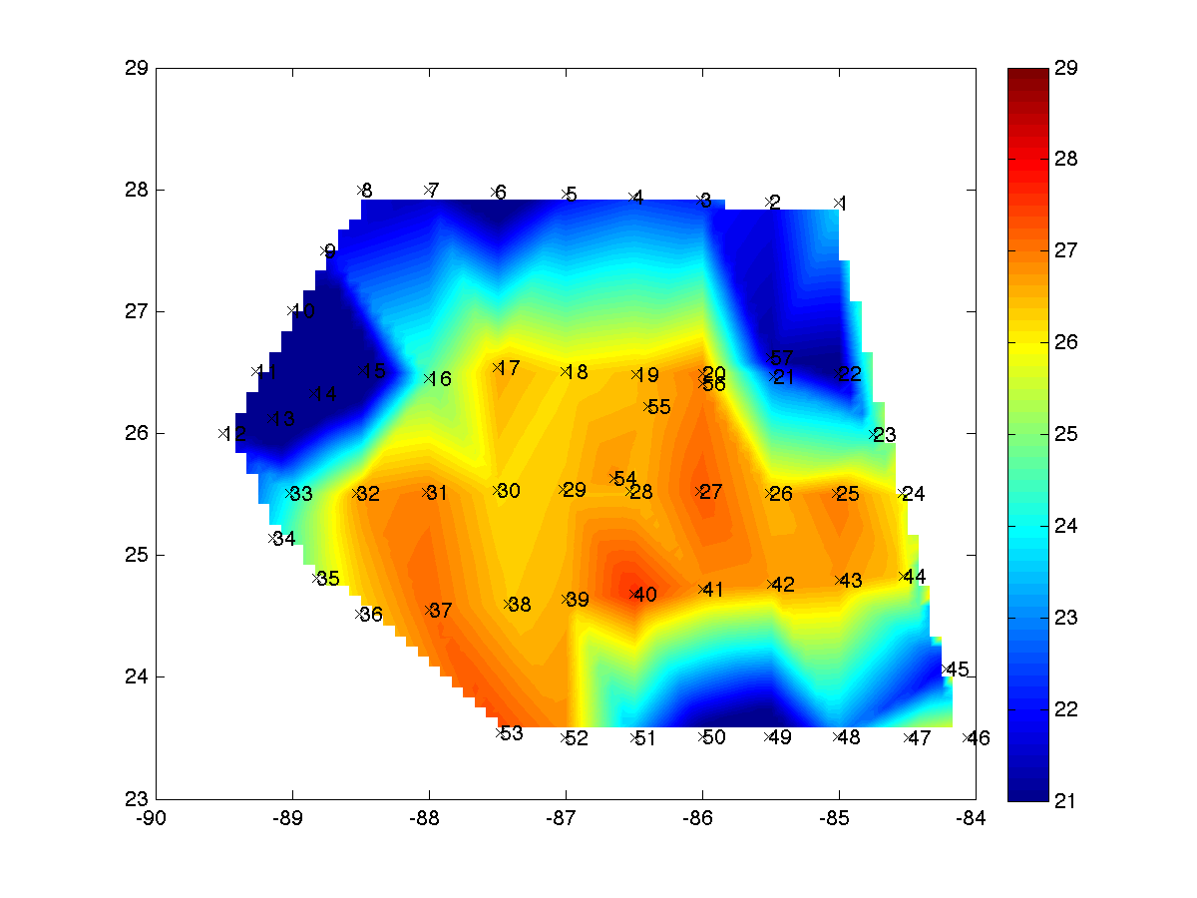
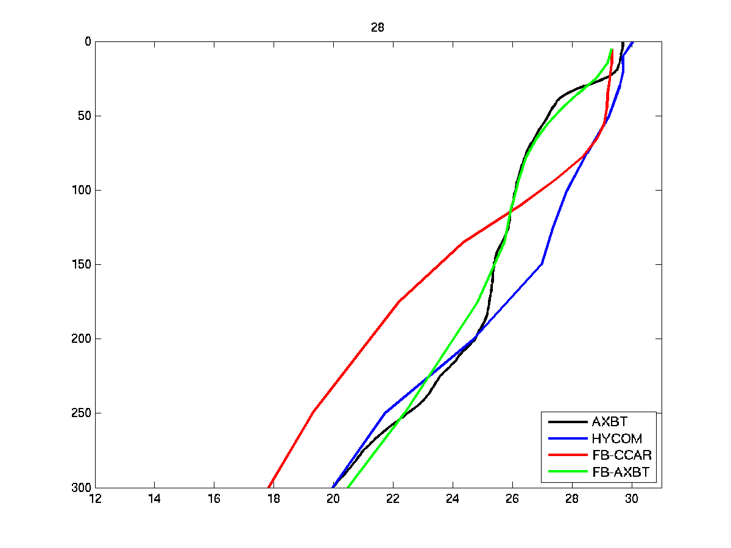
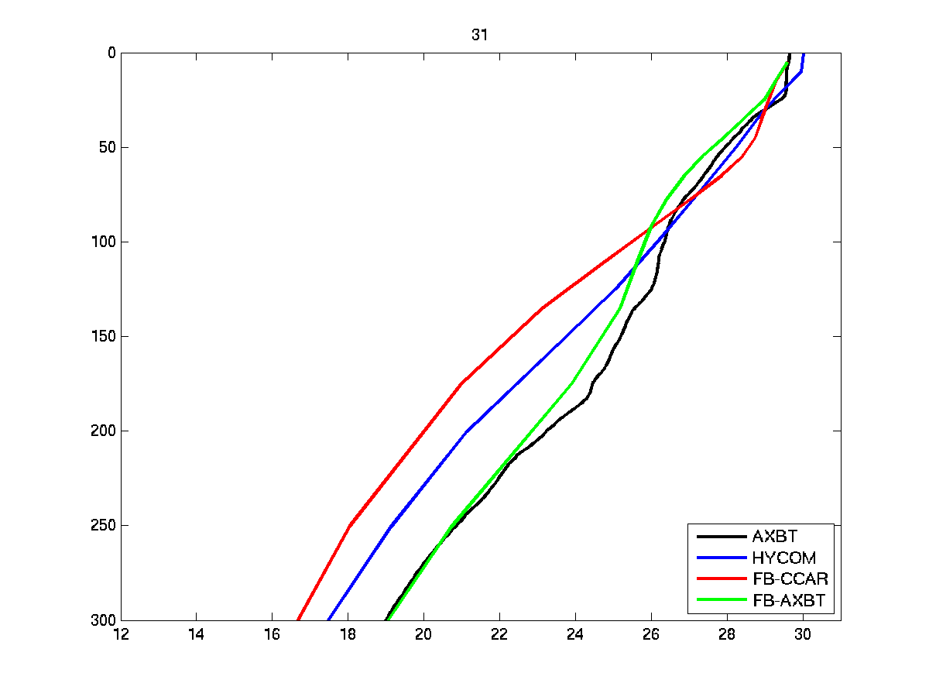
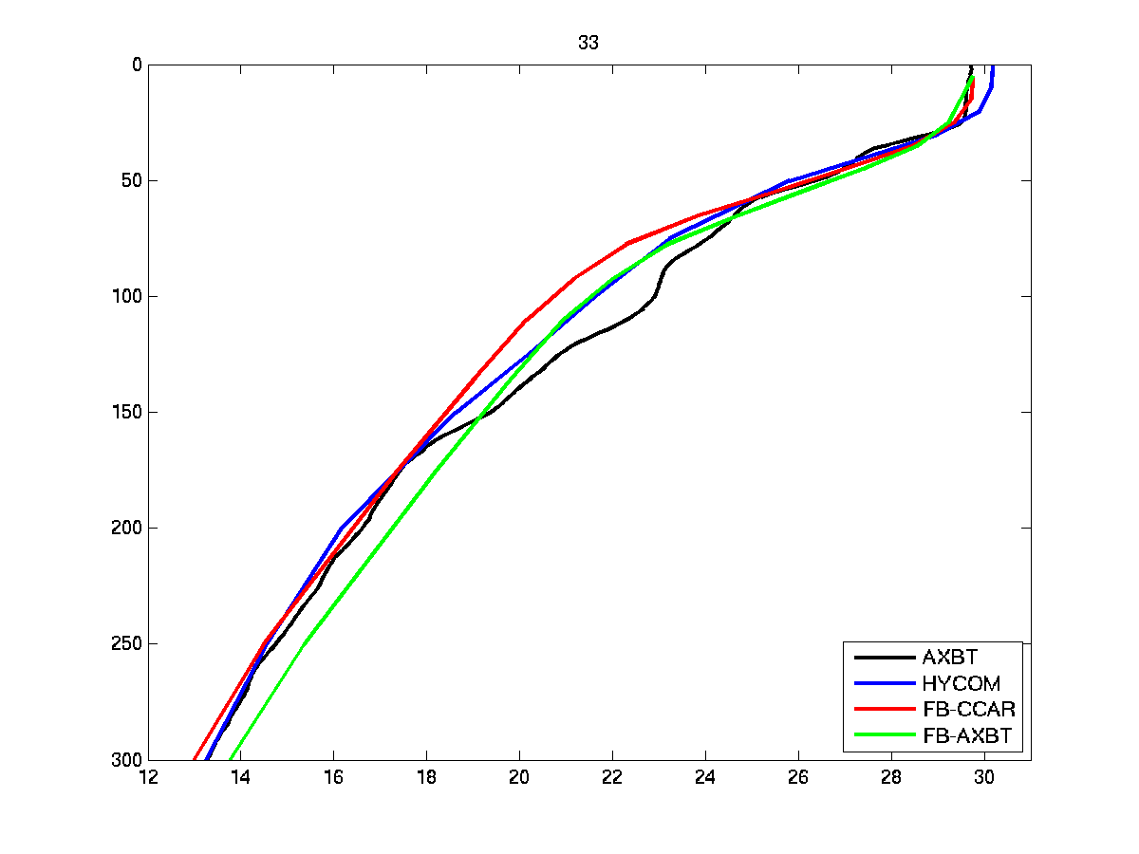
AXBT temperature profiles
Blended AXBT 75-m temperature
AXBT 28
Temperature profiles:
Global HYCOM (blue)
FB without AXBT assimilation (red)
FB with AXBT assimilation (green)
AXBT observation (black)
AXBT 31
AXBT 33

Slide 17
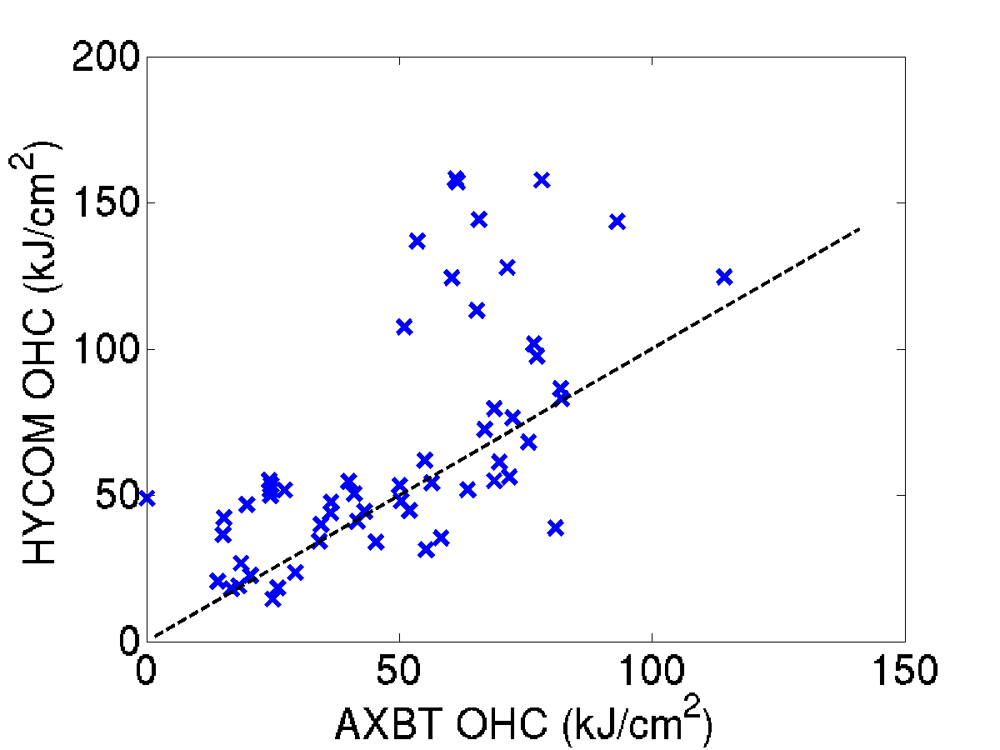
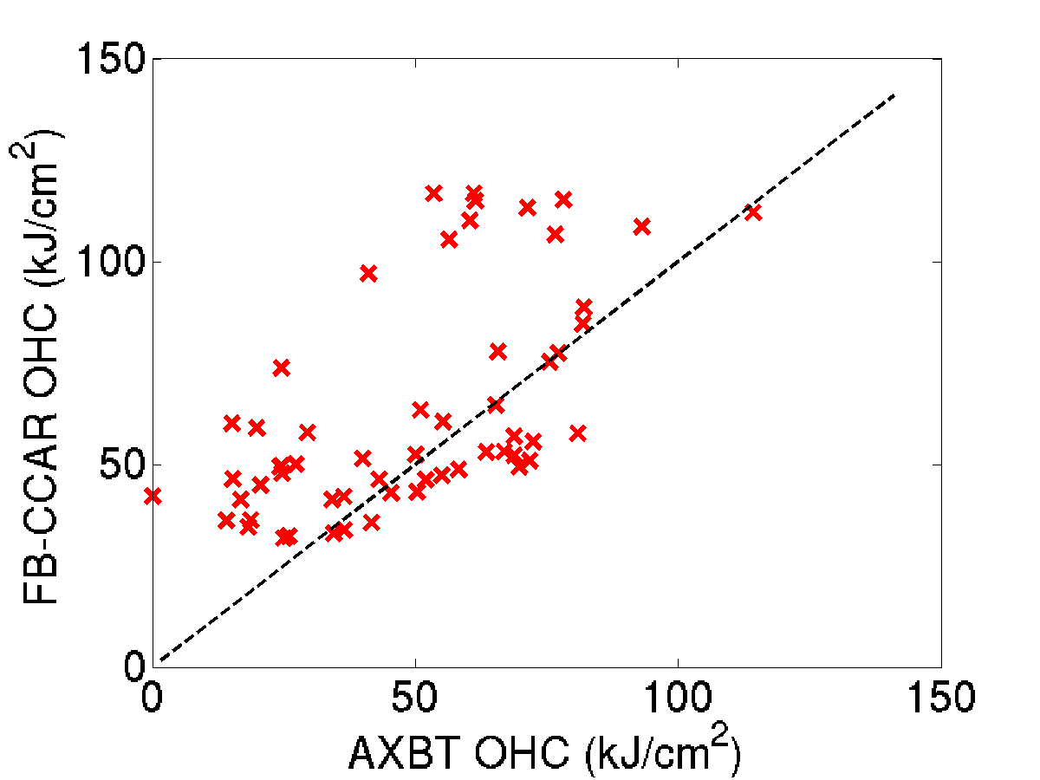
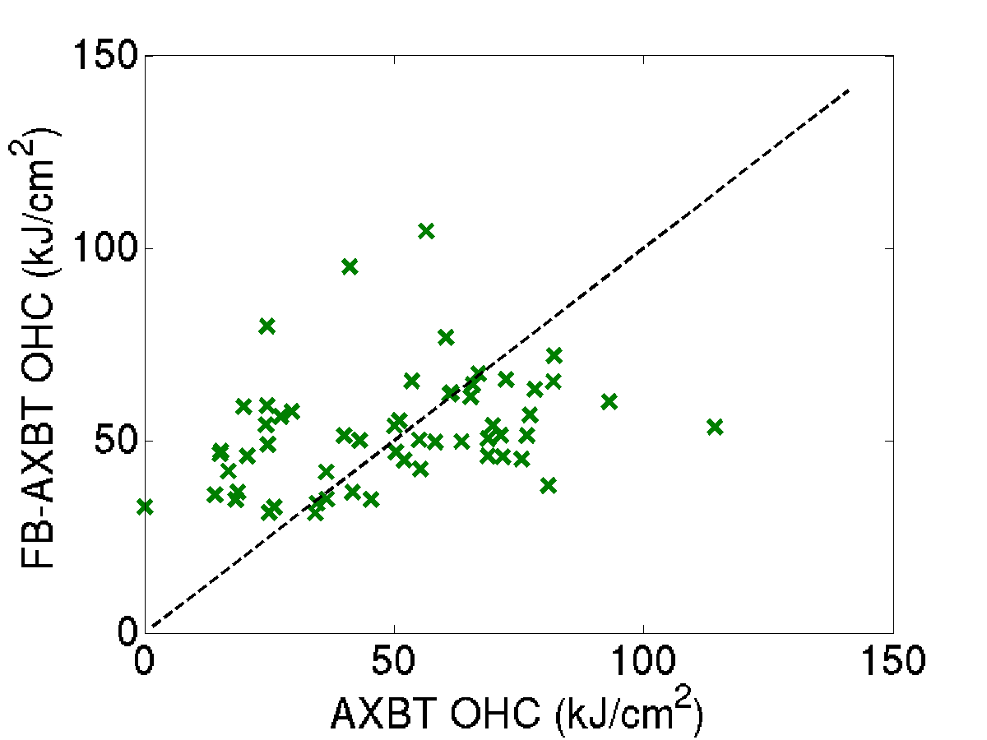
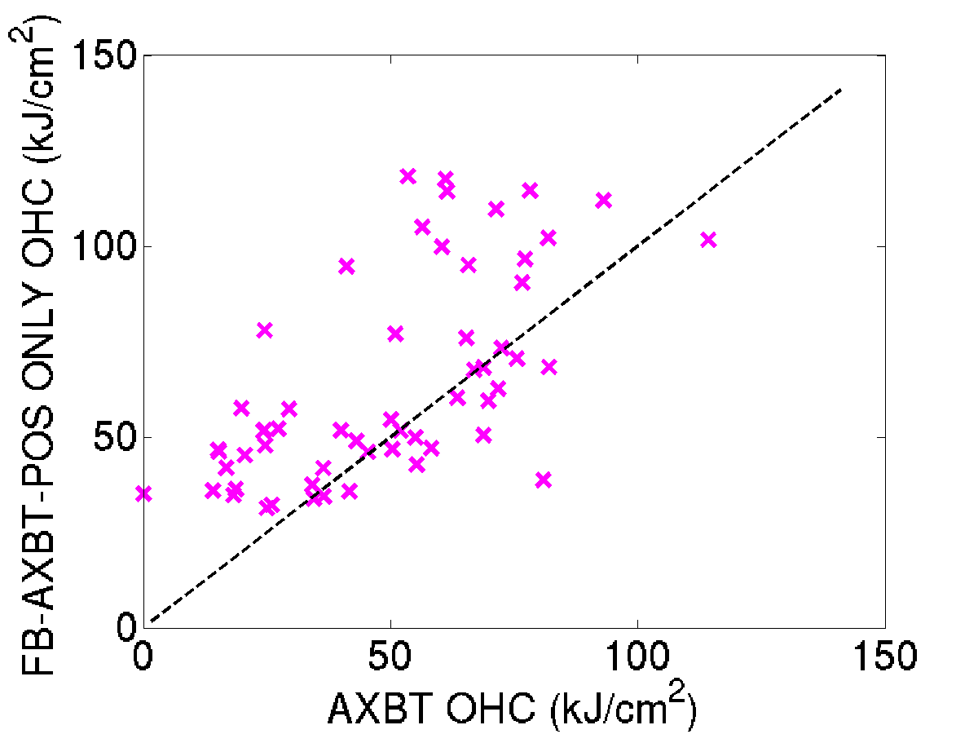
Ocean Heat Content Comparisons
HYCOM
FB-CCAR
RMSE=
34.41
RMSE=
26.42
FB-AXBT
FB-AXBT-POSONLY
RMSE=
23.82
RMSE=
26.26

Slide 18
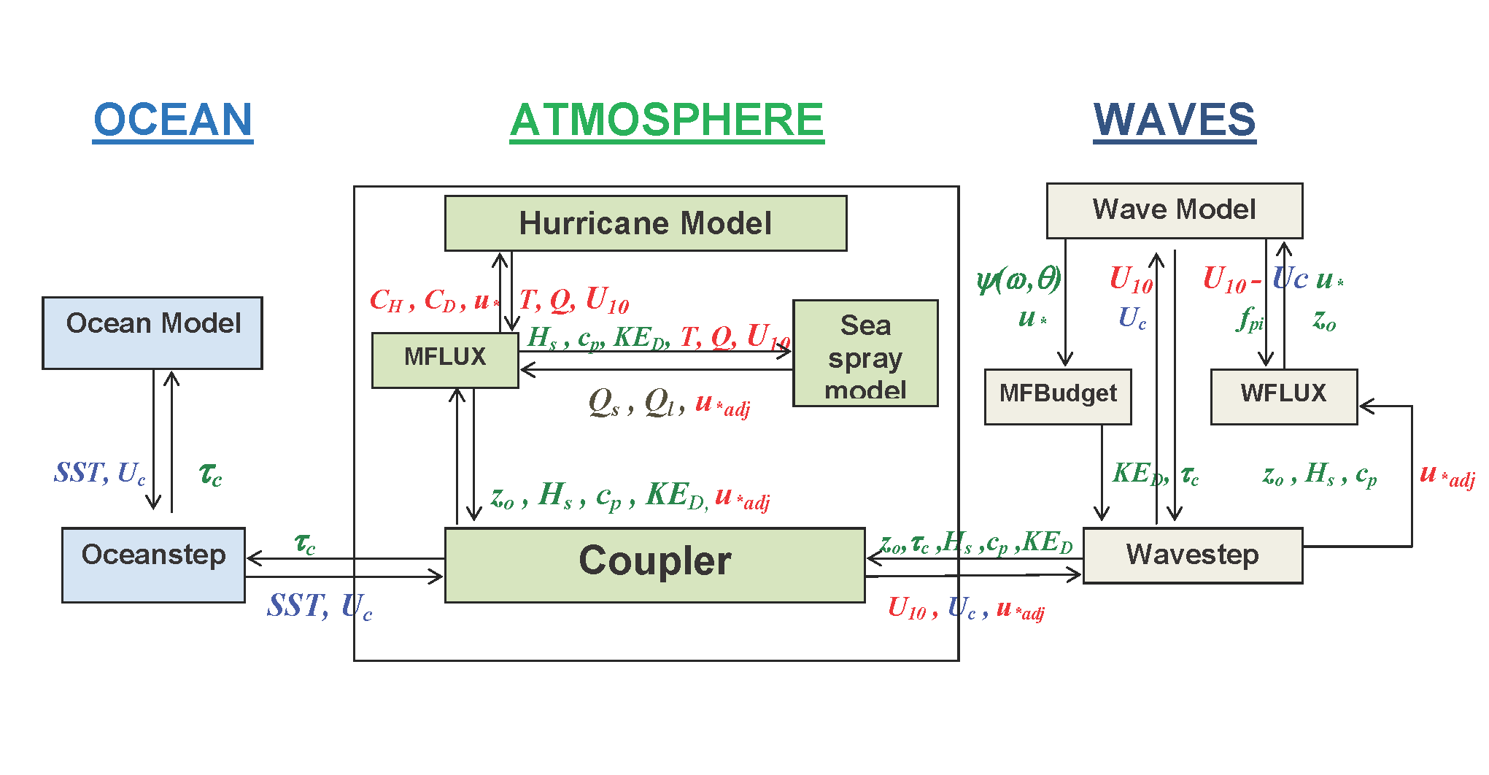
HWRF-WW3-POM and GFDL-WW3-POM
will be tested in 2013
Red - atmospheric parameters, Green – wave parameters, Blue - ocean parameters
Hurricane model: air-sea fluxes depend on sea state, sea spray and include surface current.
Wave model: forced by sea state dependent wind forcing and includes surface current
Ocean model: forced by sea state dependent wind stress modified by growing or decaying wave fields and Coriolis-Stokes. Turbulent mixing is modified by the Stokes drift (Langmiur turbulence).

